Slide 1

Marlon Dumas
From Conceptual to Executable BPMN Process Models
A Step-by-Step Method
University of Tartu
marlon.dumas@ut.ee
Slides prepared in collaboration with Marcello La Rosa (QUT) With contributions from Remco Dijkman (TU/e)

Slide 2
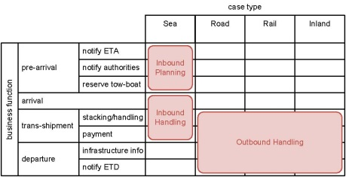
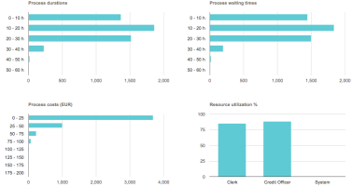
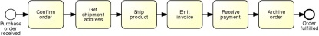
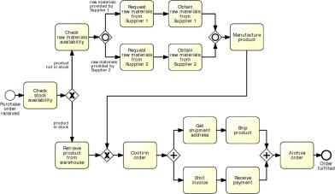
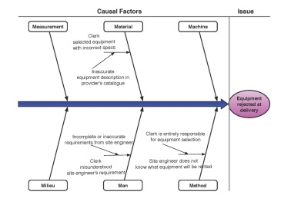
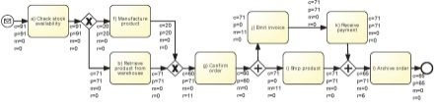
Where are we?
Notes:
Inspired by this message, one year ago we decided to survey the plethora of approaches, methods and techniques available in BPM and write this book (which builds upon) distil a comprehensive, yet succinct BPM methodology, which is the focus of this book “Fundamentals of BPM”. A methodology that would embrace the whole BPM lifecycle (without skipping any phase – in fact there are many valueable books that only focus on certain phases of the lifecycle), starting from the very beginning: process identification, through to process monitoring and controlling. Trying to strike a good balance between IT and management aspects, and would identify clear deliverables for each step of the lifecycle, by providing concrete, hands-on techniques to achieve these. For example, how I do I build a process architecture, how do I go about modeling a business process, how many discovery methods there exists, now that I have my model, what can I do with that etc.
No change management, process implementation only focuses to process automation.

Slide 3



The business-engineering gap…
Notes:
Stress that this is achieved via a BPMS and that it’s not necessarely a refinement, it’s rather an incremental transformation

Slide 4
Two sides of the BPM story
Conceptual “to-be” process models
are made by domain experts
provide a basis for communication amongst relevant stakeholders
must be understandable
must be intuitive and may leave room for interpretation
contain purely a relevant set of process information
Executable process models
are made by IT experts
provide input to a process enactment system - BPMS
must be machine readable
must be unambiguous and should not contain any uncertainties
contain further details that are only relevant to implementation
“to-be executed” process model
Notes:
Conceptual vs to-be-executed and executable
Add “to-be-executed model” as a bridge between the conceptual and executable process model

Slide 5
Bridging the gap: A five-step method
Identify the automation boundaries
Review manual tasks
Complete the process model
Adjust task granularity
Specify execution properties
Adapted from teaching material of Remco Dijkman, TU/e.
Notes:
Let’s see how we can achieve that. We propose a five-step method whereby we incrementally transform the conceptual process model in order to obtain an executable counterpart of this. First, we [read steps]. At the end of step 4 we obtain the “to-be-executed” model, which in final step gets finally transformed into the fully executable process model, by specifying execution properties.
This method is inspired from teaching material of Remco Dijkman.
Outline: we will cover the first four steps, until we obtain the to-be-executed pm in Part I of this tutorial. After the break, in Part II, we will cover the “last mile”.

Slide 6
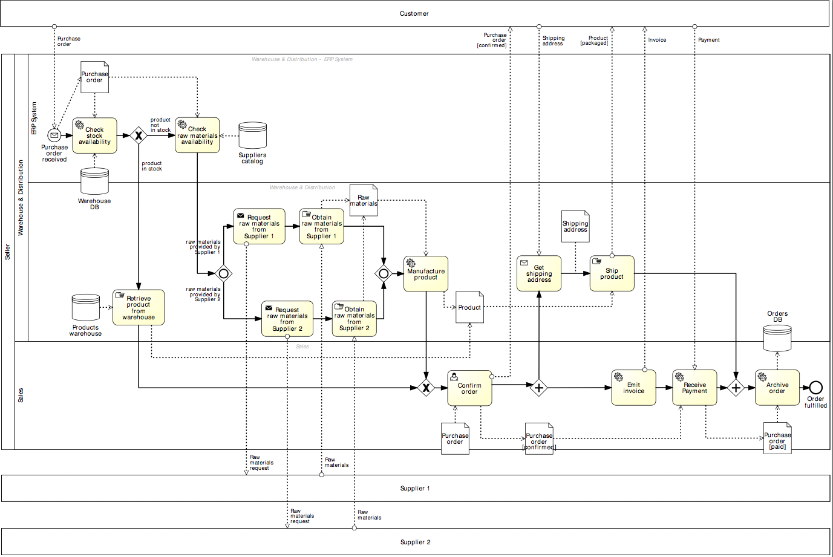
Running example
Customer
Seller
Supplier 1
Supplier 2

Slide 7
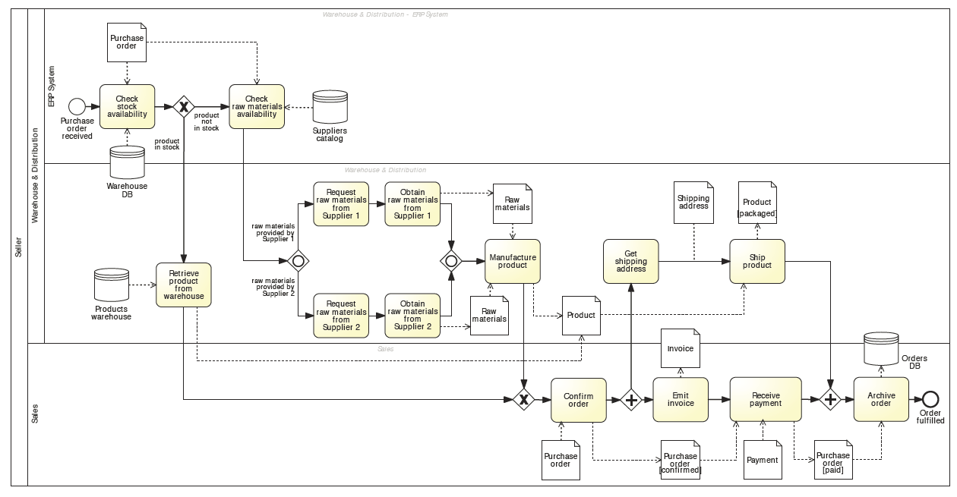
running example

Slide 8



1. Identify the automation boundaries
Principle: not all parts of a process can be automated.
-> Start by identifying each task’s type:
1
2
3
Automated tasks
User tasks
Manual tasks
Notes:
We have to be honest about that. Not all processes can be automated. So we need to start by…
We can distinguish between automated tasks, i.e. those tasks that can executed by an external application or internally to the BPMS, for example checking the stock availability through an ERP system or retrieving a document from a DMS, user tasks, those tasks where process participants need to provide input to the process, typically via the use of web forms, and finally manual tasks, those which are entirely manual, such as retrieving a product from the warehouse

Slide 9
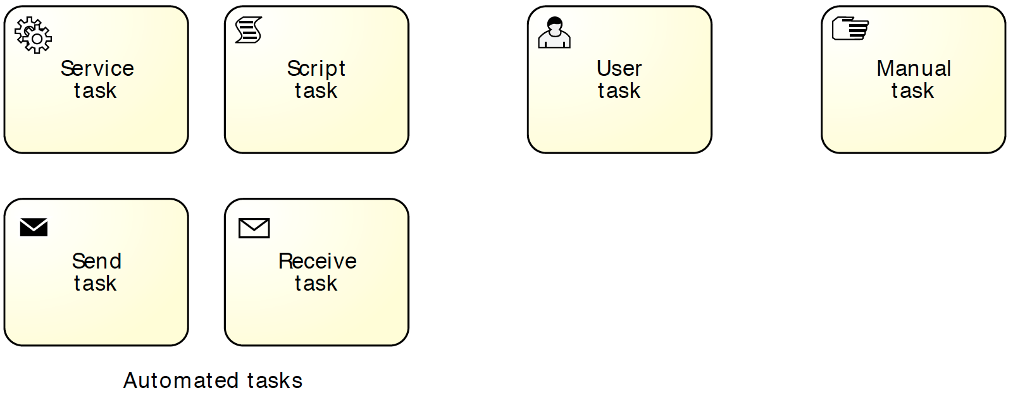
In BPMN: specify task markers
Automated tasks
User task
Manual task
Notes:
Identify automated, manual and user tasks:
Manual tasks are marked with a hand icon
User tasks are marked with a user icon (scheduled in worklist)
Automated tasks are subtyped in BPMN:
script (script marker), if the task executes some code (the script) internally to the BPMS. This task can be used when the functionality is simple and does not require access to an external application
service (wheels marker), if the task is executed by an external application, which exposes its functionality via a service interface
send (filled envelope marker), if the task sends a message to an external service
receive (empty envelope marker), if the task waits for a message from an external service

Slide 10
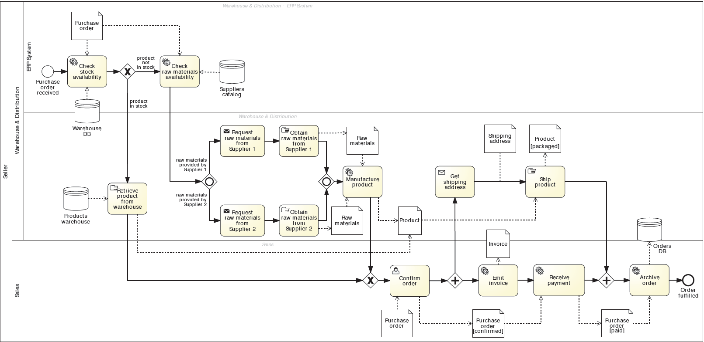
In our example…
automated
user
manual

Slide 11



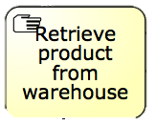
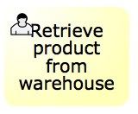
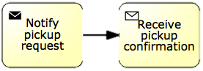
2. Review manual tasks
Principle: if it can’t be seen by the BPMS, it doesn’t exist.
-> Find ways to support manual tasks via IT:
via user task
via automated task
-> Isolate them and automate the rest
Notes:
Once we have identified each task’s type, and so the automation boundaries, we can review each manual task to see whether we can automate them or we have to isolate them. Here the principle is: …
Where the nice looking woman gets a notification on her mobile device to go and pick up the box from the shelf, and once she is done she scans the barcode of the product so that an automatic notification is sent back to the BPMS, which now knows it can move on

Slide 12

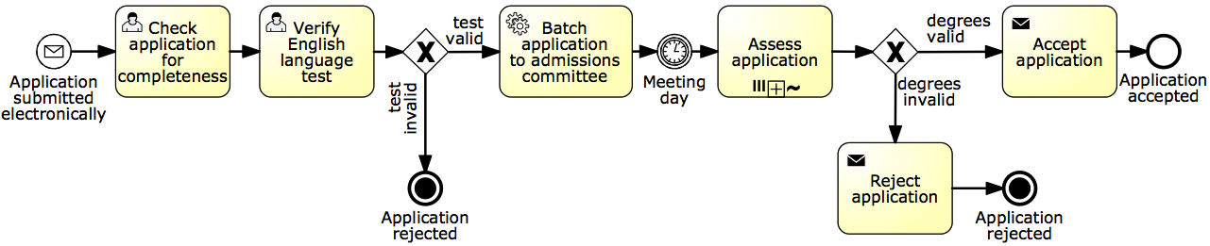
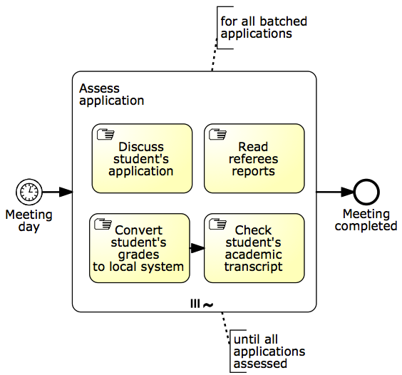
Alternative: isolate manual tasks
Notes:
Isolate manual tasks (use Example 9.1 – student admission process)

Slide 13
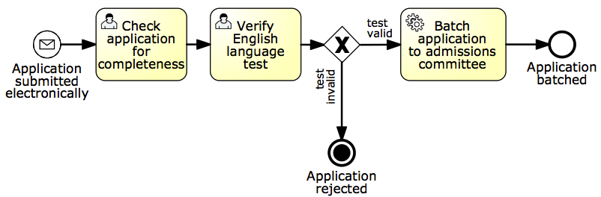
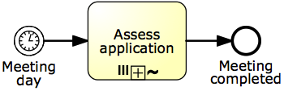
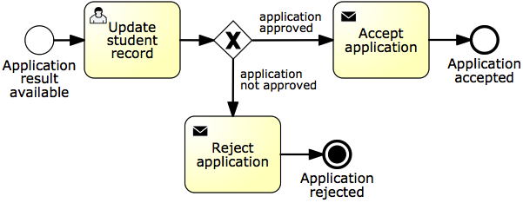
Alternative: isolate manual tasks
Segment 1
Segment 2
Segment 3
Notes:
Isolate manual tasks (use Example 9.1 – student admission process)

Slide 14
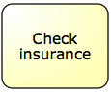
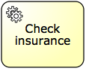
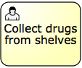
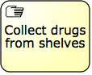
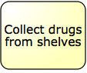
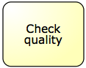
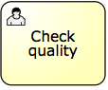
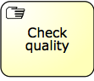


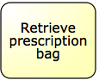
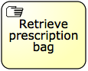
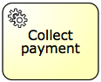
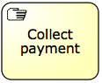
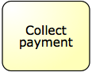
Quiz: let’s consider this process fragment
Prescription fulfillment process:
Once the prescription passes the insurance check, it is assigned to a technician who collects the drugs from the shelves and puts them in a bag with the prescription stapled to it.
After that, the bag is passed to the pharmacist who double-checks that the prescription has been filled correctly.
After this quality check, the pharmacist seals the bag and puts it in the pick-up area.
When a customer arrives to pick up their prescription, a technician retrieves the prescription and asks the customer for their payment.
Assume the pharmacy system automates this process. Identify the type of each task and link manual tasks to the system.
Notes:
Exercise 9.8
If therea are any manual tasks, find a way to hook them to the pharmacy system.
One way of modeling this fragment is by defining the following tasks: “Check insurance”, “Collect drugs from shelves”, “Check quality”, “Collect payment” (triggered by the arrival of the customer), and finally “Retrieve prescription bag”. Assume the pharmacy system automates the prescription fulfillment process. Identify the type of each task and if there are any manual tasks, specify how these can be linked to the pharmacy system.
Task “Check insurance” can be automated through a service that determines the amount of the co-payment based on the details of the prescription and on the customer’s insurance policy.
Tasks “Collect drugs from shelves” and “Check quality” are manual tasks. These tasks can be implemented as user tasks in the automated process. To do so, the pharmacy technician who collects the drugs, and the pharmacist who quality-checks the prescription and seals the bag, should have a convenient mechanism to signal the completion of these activities to the BPMS. This could be achieved by putting in place a system based on barcode scans to track prescriptions. For example, the technician would see a list of prescriptions to be filled from their worklist. They would then pick up one of the prescriptions and the system would associate the prescription to a new barcode which is printed on an adhesive label. The technician would then attach the label to a bag, collect the drugs and put them in a bag, and when done, they would scan the barcode from the label to record that the prescription has been fulfilled. This signals the completion of task “Collect drugs from shelves” to the pharmacy system. In turn, it generates a new work item of task “Check quality” in the pharmacist’s worklist. The pharmacist can then quality-check the prescription and scan the barcode again.
Task “Collect payment” is also a manual task. This task could be implemented as a service task whereby the pharmacy system would push the task of collecting the payment for a prescription to a Point-of-Sale (POS) system and expect the POS system to indicate that the payment has been collected. The pharmacy technician would interact with the POS system once the customer arrives, but this interaction is outside the scope of the pharmacy system. The pharmacy system merely pushes work to the POS system and waits for completion.
The description of the process implicitly refers to a manual task whereby the pharmacist seals the bag and puts it into the pick-up area. However, this “Seal bag” task is not included in the executable process model. Instead, this task is integrated into the “Check quality” task. In other words, at the end of the quality check, the pharmacist is expected to seal the bag if the prescription is ready and drop the bag in the pick-up area.
Task “Retrieve prescription bag” is also manual but there is no value in automating it in any way. So this task is left out of the executable process model, which completes once the payment has been made.

Slide 15

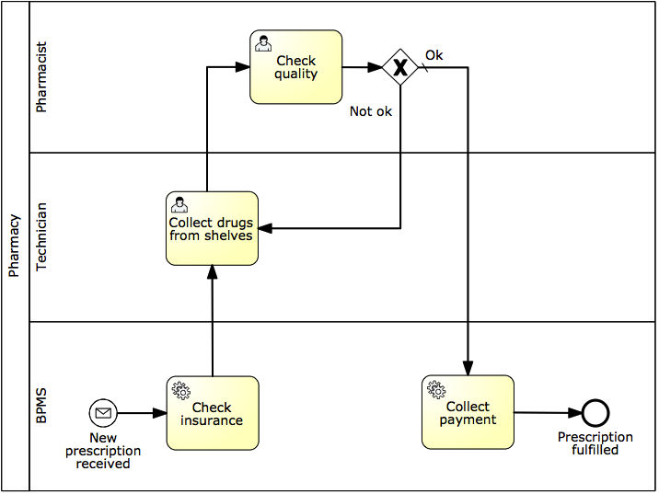
Possible solution
Notes:
TODO: Exercise 9.8 (prescription fulflliment process)

Slide 16
3. Complete the process model
(cf. Last week‘s lecture)
Principle 1: exceptions are the rule.
Consider incomplete paths
Rules of thumb
If we send something to another party, what happens if they do not respond? What happens if the response comes late? What happens if they do not respond the way we expect?
For each task: Can it go wrong and what happens if it goes wrong?
For each external party: Have we captured all messages or queries they might send us? (use CRUD)
Principle: no data = no decisions, no tasks handover.
Specify all (electronic) business objects
For each task, determine which business objects it creates, reads, updates, delete (CRUD)
For each decision, determine which objects it needs
Notes:
Process exceptions happen all the time and for as intelligent as a modern system can be, it can never foresee exceptions, which we need to implement, though it doesn’t need to be done all at once, it can be done in stages.
Tech-related exceptions: system crash, network outage, service unavailability, data mismatch
Bus-related: product discontinuation, order cancelation, out-of-stock items
BAs legitimately think it’s not relevant for communication purposes, they assume it’s common knowledge or they are not (fully) aware of it.
So first we need to Check for coverage of exceptions. Then we need to Specify all electronic data objects and split conditions

Slide 17
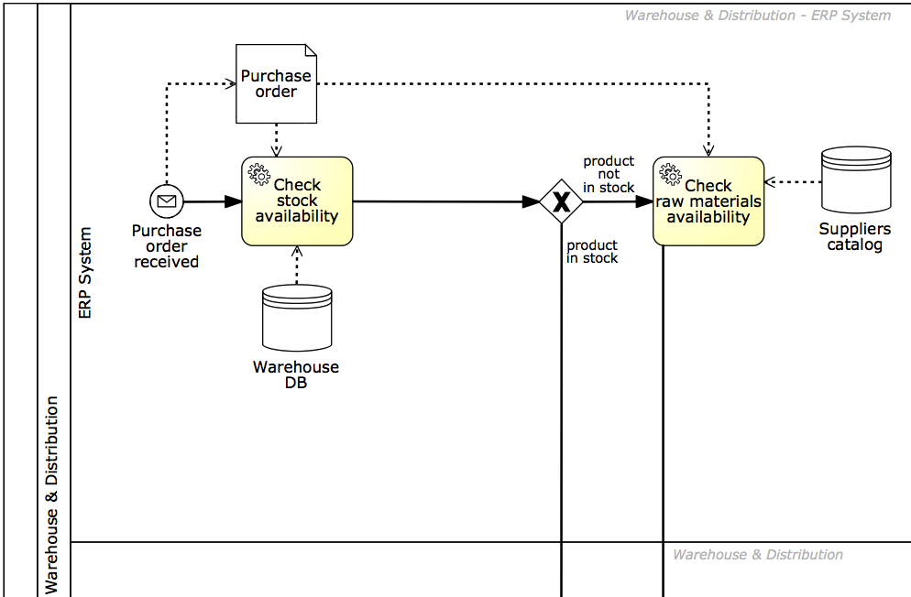
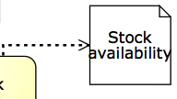
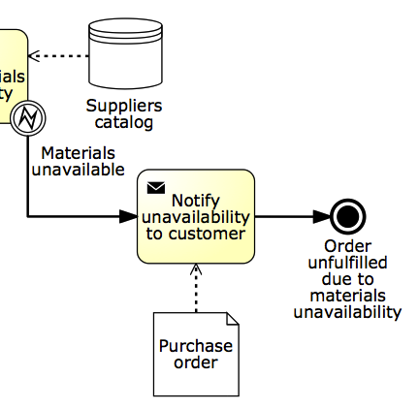
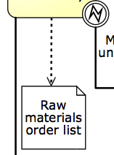
In our example…
Notes:
So first we need to Check for coverage of exceptions. Then we need to Specify all electronic data objects and split conditions

Slide 18


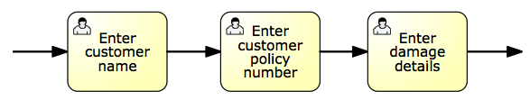
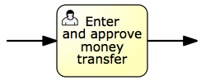
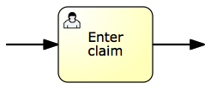
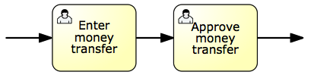
4. Adjust task granularity
Principle: BPMSs add value if they coordinate handovers of work between resources.
-> Aggregate any two consecutive tasks assigned to the same performer
-> Split tasks if they require different performers
Notes:
There is not necessarily a 1-1 mapping between tasks in a conceptual process model and those in the executable counterpart.
Principle: a BPMS is intended to coordinate and manage handovers of work between multiple resources (human or non-human). Accordingly, two or more consecutive tasks are candidate for aggregation. If this was the case, the BPMS would not add any value as it would not manage any handover of work
Similarly, if an activity requires more than one resource to be executed, it is too coarse-grained and thus needs to be refined.
Aggregation: Enter customer name, enter customer policy number and enter damage details into Enter claim, if performed by the same claims handler
Refinement: Enter and approve money transfer, typically performed by two different participants with the same role, financial officer, in order to enforce a separation of duties

Slide 19
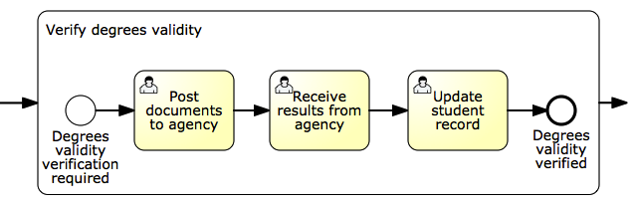
An exception to the rule
Notes:
Remember the student admission process?
Let’s take a look at this subprocess “Verify degrees validity”…
While these may be performed by the same admin clerk, we do want to report the completion of each task to the BPMS for the sake of monitoring the progress of the application, for example for auditability, also because there is typically some idle time between each task (e.g. after the documents have been posted and before receiving the results). It is also useful in this case to manage potential exceptions. For example, if the results aren’t received within a given timeframe, we can handle this delay with an exception handler attached to this task.

Slide 20
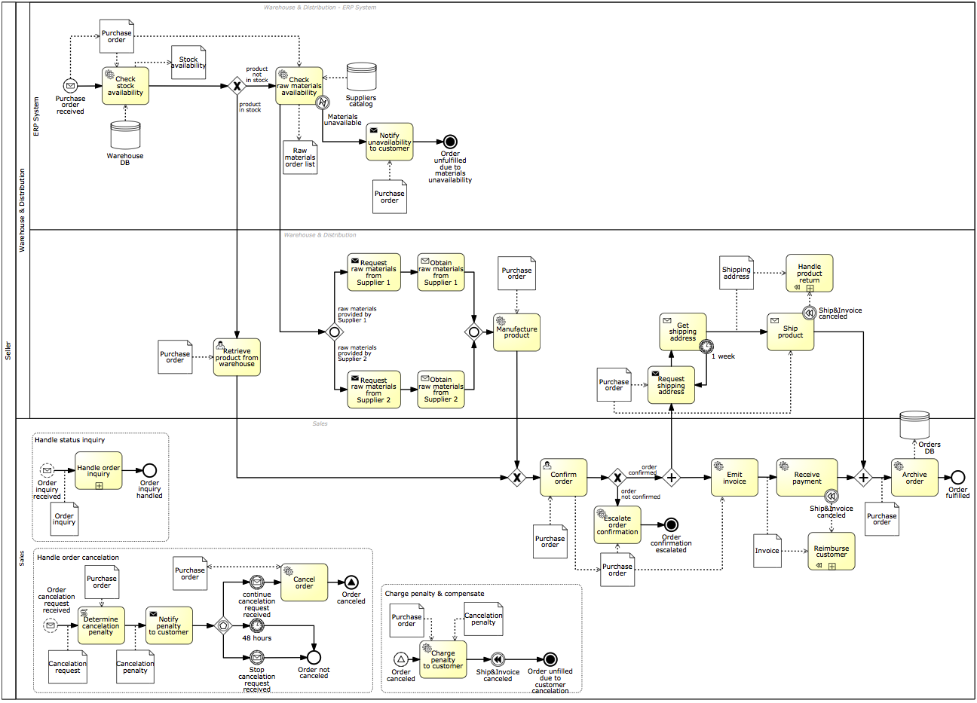
Our example…
After Step 4
Before Step 1

Slide 21
Bridging the gap: one task at a time
Identify the automation boundaries
Review manual tasks
Complete the process model
Adjust task granularity
Specify execution properties
Notes:
Recap

Slide 22

5. Specify execution properties
-> Process variables, messages, signals, errors
-> Task and event variables and their mappings to process variables
-> Service details
-> Code snippets
-> Participant assignment rules and user interface structure
-> Task, event and sequence flow expressions
-> BPMS-specific: work queues, forms, connectors…
Notes:
So far we have obtained a “to-be-executed” process model. Up until this point, business analysts can be involved, so these first four steps are not a prerogative of technical staff. However, the last step is something that requires knowledge of the system and related technologies. In fact, in this step we need to specify:

Slide 23
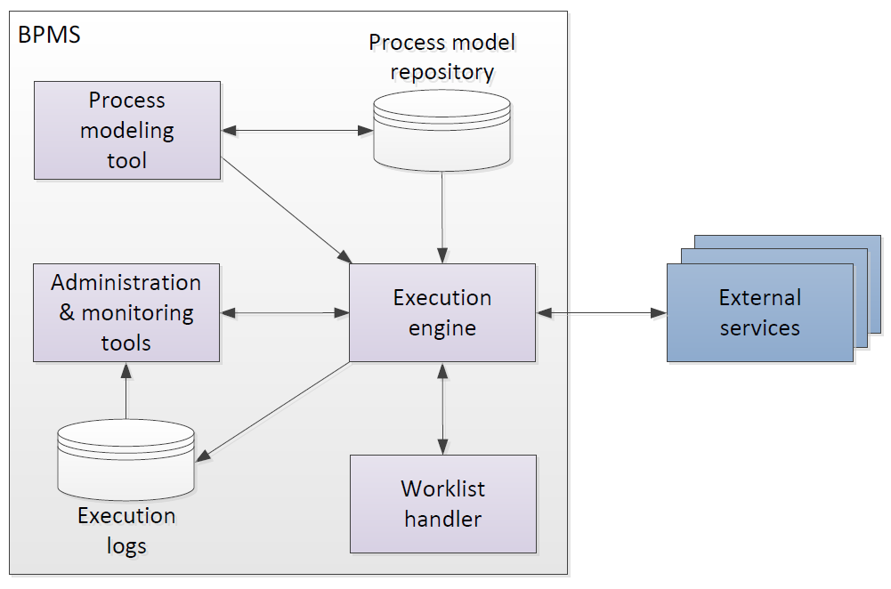
Business Process Management System
Notes:
External services, e.g. a business rules engine (sometimes available as an internal component)
If the previous slide is skipped, this slide can simply be called “Typical architecture of a BPMS”

Slide 24
Process modeling tool
To create and modify executable process models (by specifying execution properties)
To store and retrieve automation solutions from a process model repository
May import from conceptual process modeling tools

Slide 25
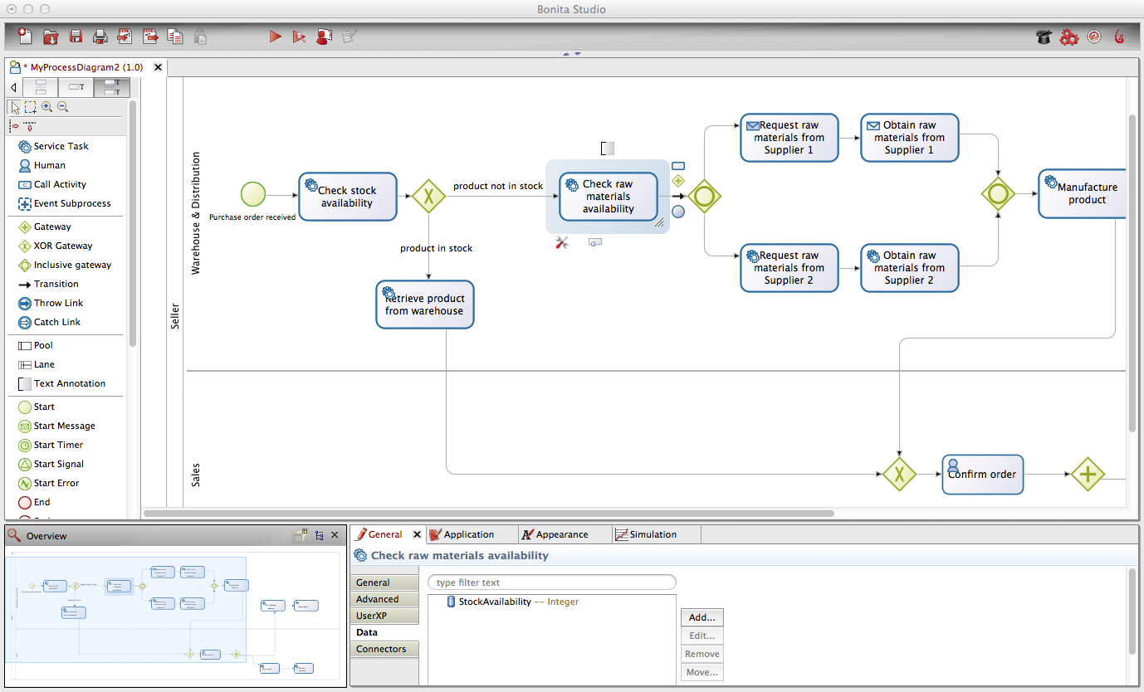
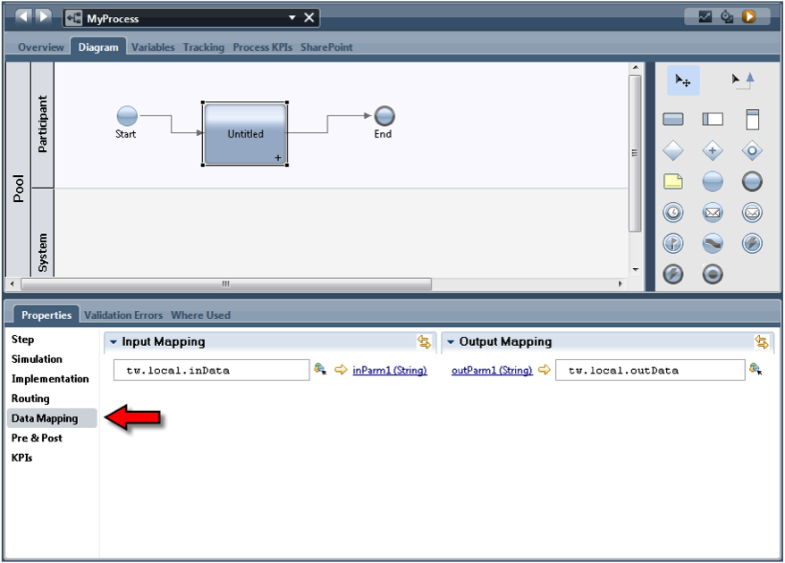
Example process modeling tools
IBM Business Process Manager
Bonita Soft Bonita Open Solution
Notes:
Focus on the interface to specify extra properties

Slide 26
Execution Engine
Instantiates executable process models (also called “cases”)
Orchestrates distribution of work items to process participants and software services in order to execute a business process from start to end
Logs execution data

Slide 27
Worklist Handler
Imagine it as an “inbox”
Offers work items to process participants and allows participants to commit to these work items
Handles participants’ work queues and work item priorities
May provide social network capabilities

Slide 28
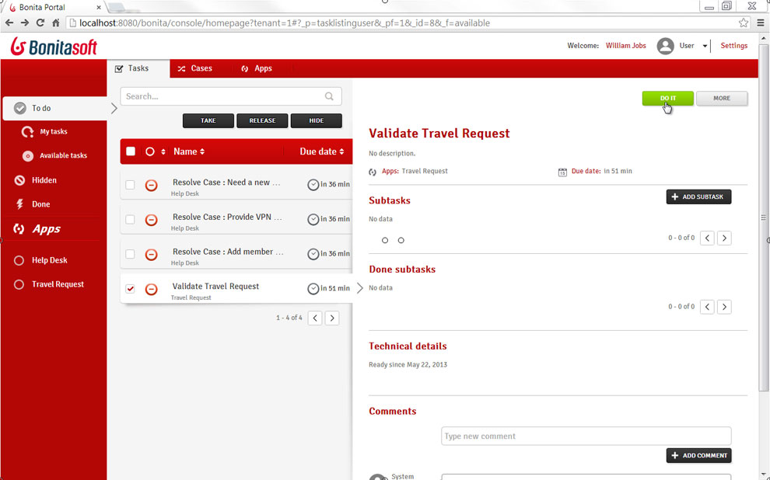
Example worklist handlers
Bonita Soft Bonita Open Solution
Notes:
TODO: add example with social network capabilities from Appian. Comment on social network capabilities of commercial worklist handlers

Slide 29
Administration & Monitoring Tools
To manage automation solutions
To configure access to system components
To monitor participants availability and performance of process cases

Slide 30
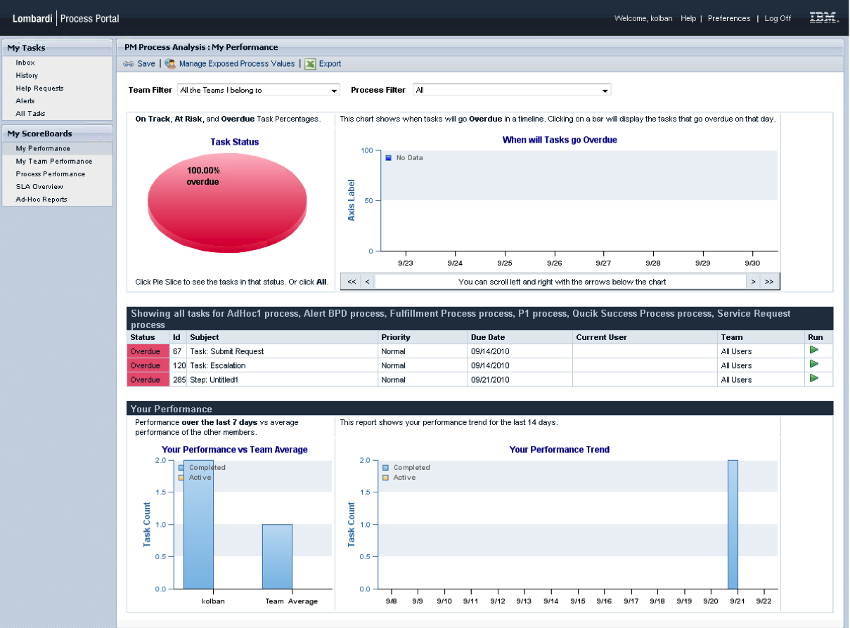
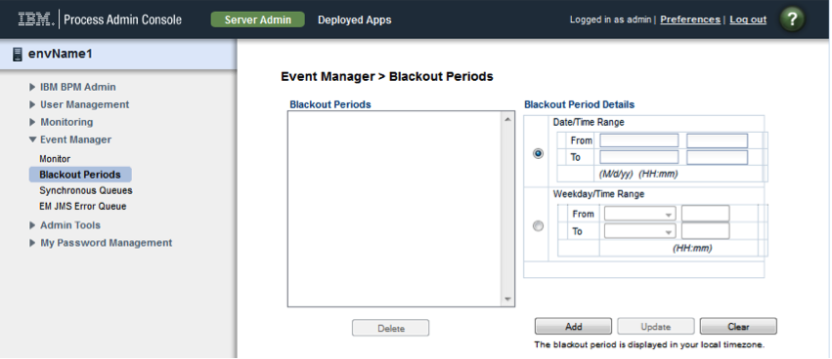
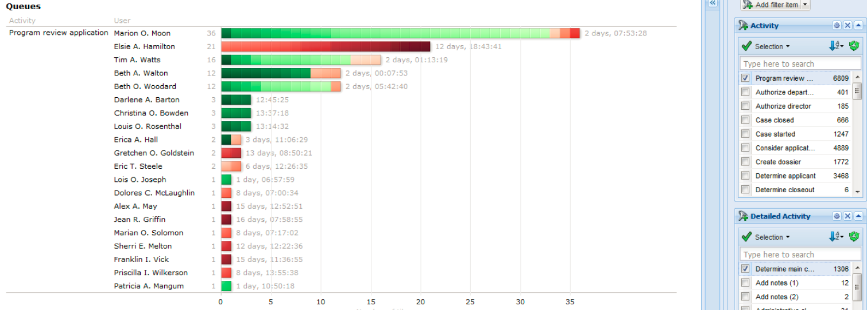
Example monitoring & administration tools
Perspective BPMOne
IBM BPM Process Admin Console
IBM BPM Process Portal

Slide 31
External Services
Expose a service interface with which the engine can interact
The engine provides the invoked service with the necessary data it will need to perform the activity for a specific case
Examples: rules engine, email or Twitter notification, DB connector, CRM connector…

Slide 32
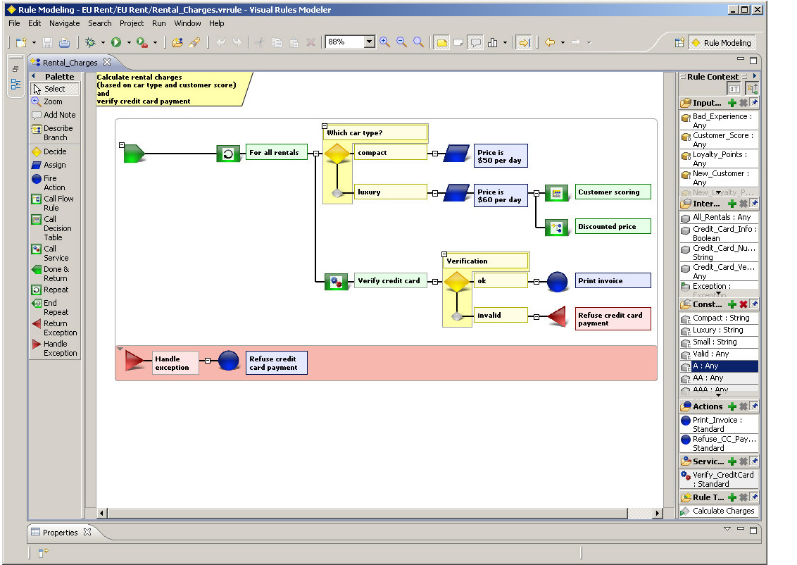
Example external services
Bosch Visual Rules editor

Slide 33
BPMS Landscape
Big vendors
Oracle BPMS
Microsoft BizTalk, Wf
Other closed-source
Appian BPMS
BizAgi BPM Suite
SAP NetWeaver BPM
Software AG webMethods
Pagaystems PegaRULES
IBM BPM
OpenText BPM
Perceptive BPMONe
Commercial open-source
Bonita Open Solution
Camunda Fox
Intalio|BPM
Bosch inubit Suite
JBoss jBPM
Shark
YAWL
Effektif (cloud)
Progress Savvion (cloud)
Notes:
A lot of choice. In large commercial projects, the engines on the left column are an option, since upfront licensing costs can be absorbed either by a project, or more frequently, by multiple projects (BPM program). It is worth noting that Microsoft offers two options: BizTalk which has a large number of integration features (all sort of adapters and integration tools), and Windows Workflow Foundation, which is more geared towards smaller projects.
In smaller projects/companies, the other closed-source engines are an option. These compete with open-source solutions, among which we can clearly distinguish between commercial open-source (companies making revenue out of consultancy, training and branding), and community open-source.
In this course we well use YAWL for 3 reasons:
Very easy and relatively lightweight installation (both on Windows and Mac), and small footprint – Cf. YAWL4Study
Quite advanced resource management features, good for illustrating various ways of assigning tasks to actors
Freely available, no restriction

Slide 34


Cheat sheet
> specify sequence flow expressions…
Control flow
Data flow
Resources
> specify data types and data mappings
> specify participants assignment rules, service details...

Slide 35

Resources
Decision logic
User Interface
External services
Control flow
Data artifacts
Notes:
Note for MD: as previous, what is the origin of this image? Copyright notes: pending advice from MD (LR)

